Slide 1

Analysis for
HATE CRIMES (2017 – 2025)
Mary Arshad
Big Data & Cloud Computing
Professor: Collin Murray

Slide 2
DATA SET:
Data.gov
Derived on: April 15th
City of Austin
Texas is the second largest state in the United States by both land area and population
Austin is currently the 11th largest city in the United States.

Slide 3
Project Journey:
Chronic Disease Dataset (didn’t work)
Created one Dashboard on Snowflake
Integrated the Snowflake Server to Tableau
Created the second Dashboard on Tableau
Tried Using Forecasting Models but didn’t work

Slide 4
Hate Crime
A hate crime is a traditional criminal offense, like assault or vandalism, that is motivated by bias against a victim's race, religion, disability, sexual orientation, ethnicity, gender, or gender identity.
It's essentially a crime where the offender targets a victim based on their actual or perceived characteristics.

Slide 5
Methodology
Data Collection The dataset, covering hate crime incidents in Austin from 2017 to 2025, was imported into a Snowflake cloud data warehouse for secure, scalable storage and querying.
Data Preparation Using SQL in Snowflake, raw records were cleaned and structured. Key preprocessing steps included:
Standardizing date formats and filtering years 2017–2025
Handling missing or "unknown" values in offender race.
Creating derived fields (e.g., extracting day of the week, month, and year from timestamps)
Data Analysis & Aggregation SQL queries were used, and Calculated fields were created in Tableau.
Data Visualization Cleaned data was connected directly to Tableau, where various visualizations were created, including:
Time series charts, pie charts, and bar graphs
Bubble maps for location-based analysis
Cross-tab tables for offender/victim breakdowns
Interpretation Visualizations were interpreted to identify trends and insights—such as peak years, most common biases, and where/when hate crimes occurred most frequently.

Slide 6
Snowflake Dashboard

Slide 7
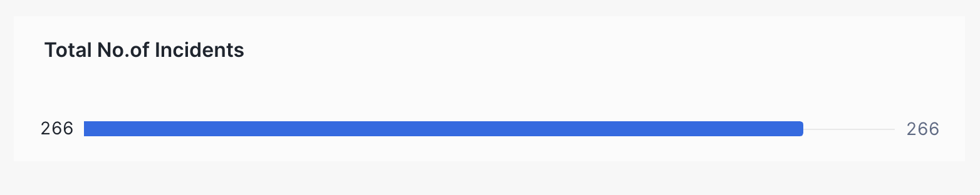
Initial Learnings
No. of Victims Under 18
No. of Victims Over 18
268
12
No. of Offenders Over 18
No. of Offenders Under 18
20
233

Slide 8
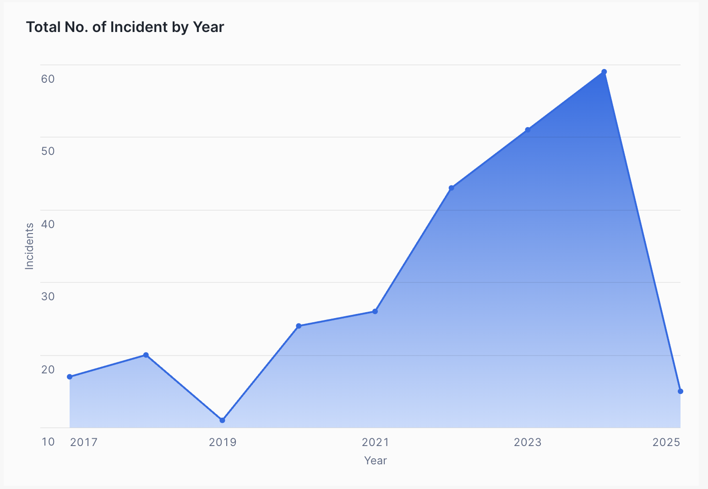
Total No. of Incidents by Year
2017 to 2018: A small increase in incidents, suggesting slight growth in reported or observed cases.
2019: A notable drop—the lowest in the observed period. This could be due to reporting gaps, policy changes, or an actual decrease in incidents.
2020 to 2021: Incidents began to climb steadily, marking a return to previous levels and some growth.
2022 to 2024: A sharp surge in incidents, peaking in 2024 at approximately 60 incidents
2025: A steep decline back to 2017-levels (~17 incidents). This drop could be due to incomplete data, intervention policies, or a lag in data collection/reporting.

Slide 9
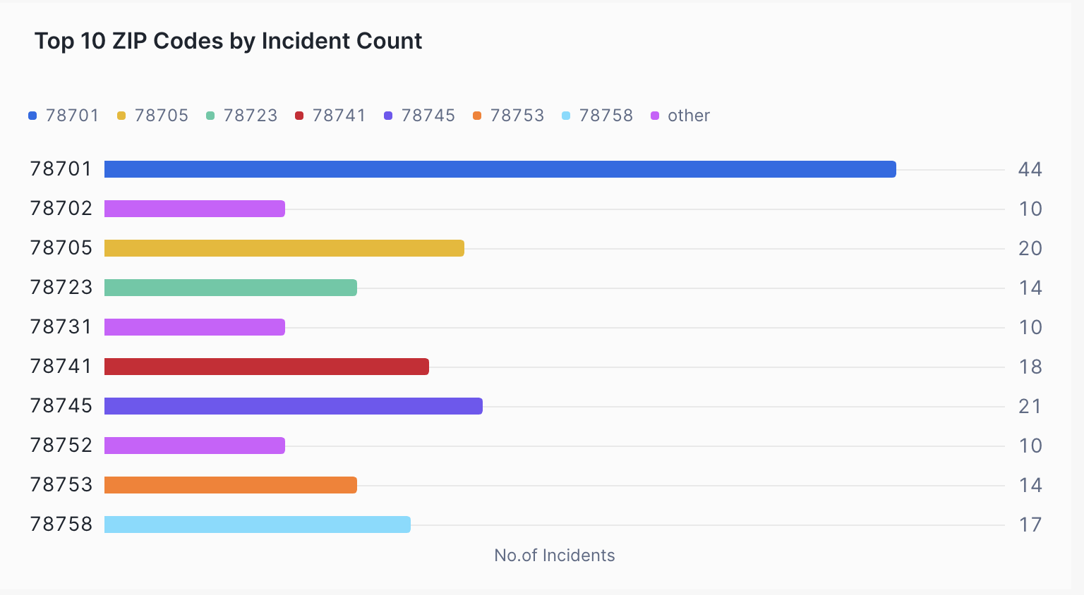
Geographic Hotspots of Hate Crimes
ZIP 78701 has the highest number of incidents (44), significantly more than any other area.
Other ZIPs like 78745 (21), 78705 (20), and 78741 (18), shows the second most criminal activity.
ZIPs 78702, 78731, and 78752 have the fewest among the top 10 (all with 10).

Slide 10
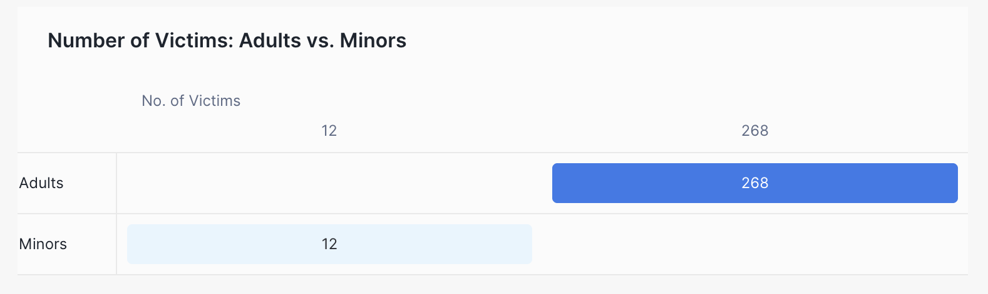
Victim Demographics: Adults vs. Minors
Adults make up the overwhelming majority with 268 victims.
Minors account for only 12 victims.
Adults are far more affected in the recorded incidents, comprising over 95% of all victims. This suggests the need for focused intervention and support services for adults in these cases.

Slide 11
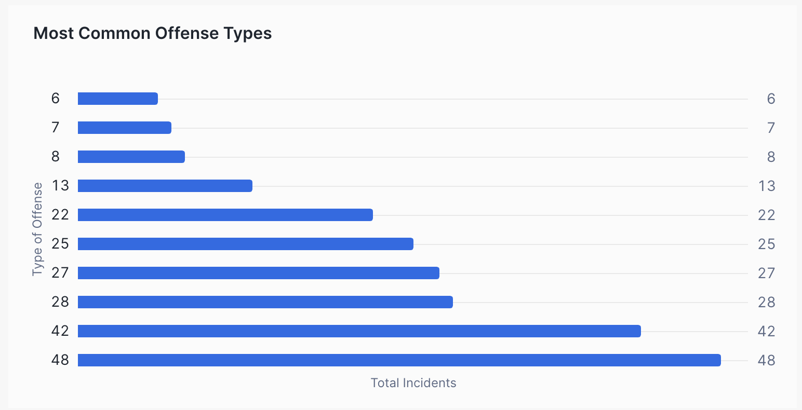
Top Offense Types by Incident Frequency
The most common offense type occurred 48 times, followed by others at 42, 28, and 27 incidents.
The top 5 categories likely include Aggravated Assault, Terrorist Threats, Assault, Harassment, and Criminal Mischief (though the exact offense types are listed only separately in the legend).
Less frequent offenses occurred fewer than 10 times, showing a steep drop-off after the top few categories.
Criminal Mischeif
Harrassment
Assault
Terrorist threats
Aggravated Assault

Slide 12
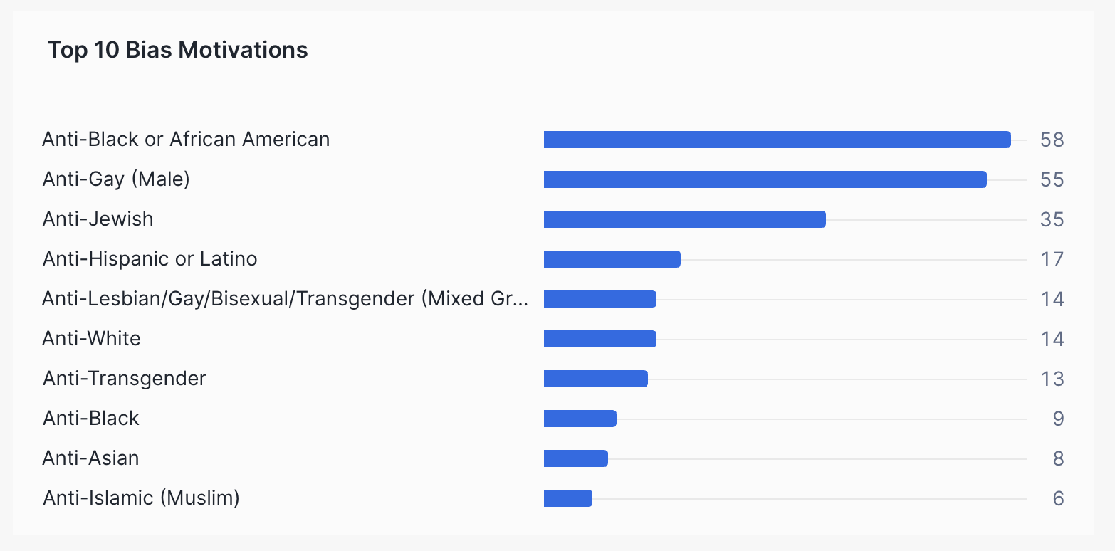
Leading Bias Motivations Behind Hate Crimes
The most frequent bias motivations are:
Anti-Black or African American
Anti-Gay (Male)
Anti-Jewish
Other notable categories include:
Anti-Hispanic or Latino
Anti-LGBTQ+ (Mixed Group)
Anti-White

Slide 13
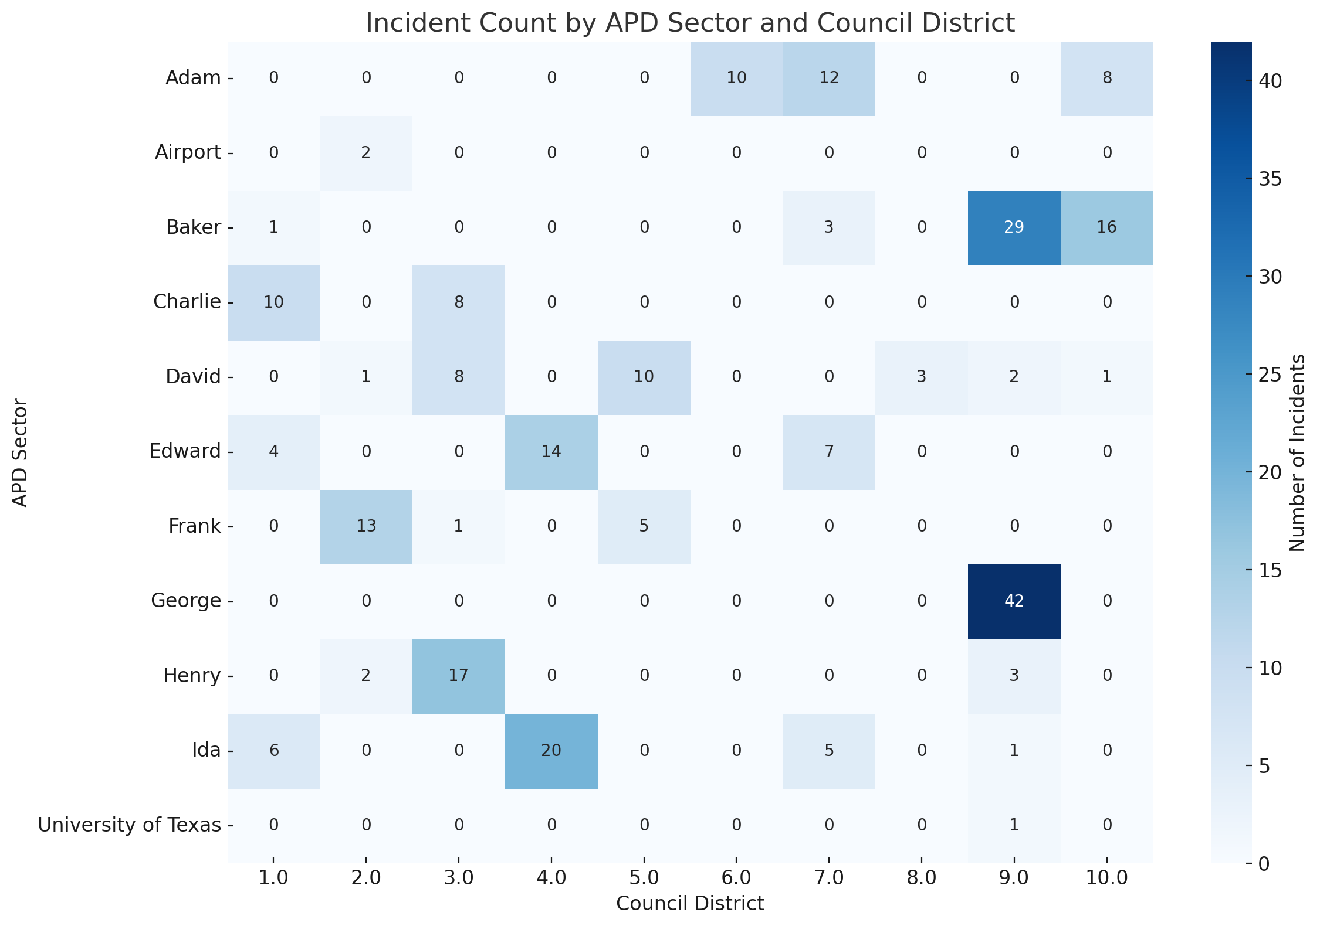
APD Performance Analysis
George Sector – District 9 had the highest number of incidents (42), suggesting a potential hotspot.
Baker Sector also showed significant counts in Districts 9 and 10, with 29 and 16 incidents respectively.
Several sectors such as Charlie, Henry, and Ida had notable incident activity across multiple districts.
Some combinations show no incidents at all, which may indicate either low activity or underreporting.

Slide 14
Tableau Dashboard

Slide 15
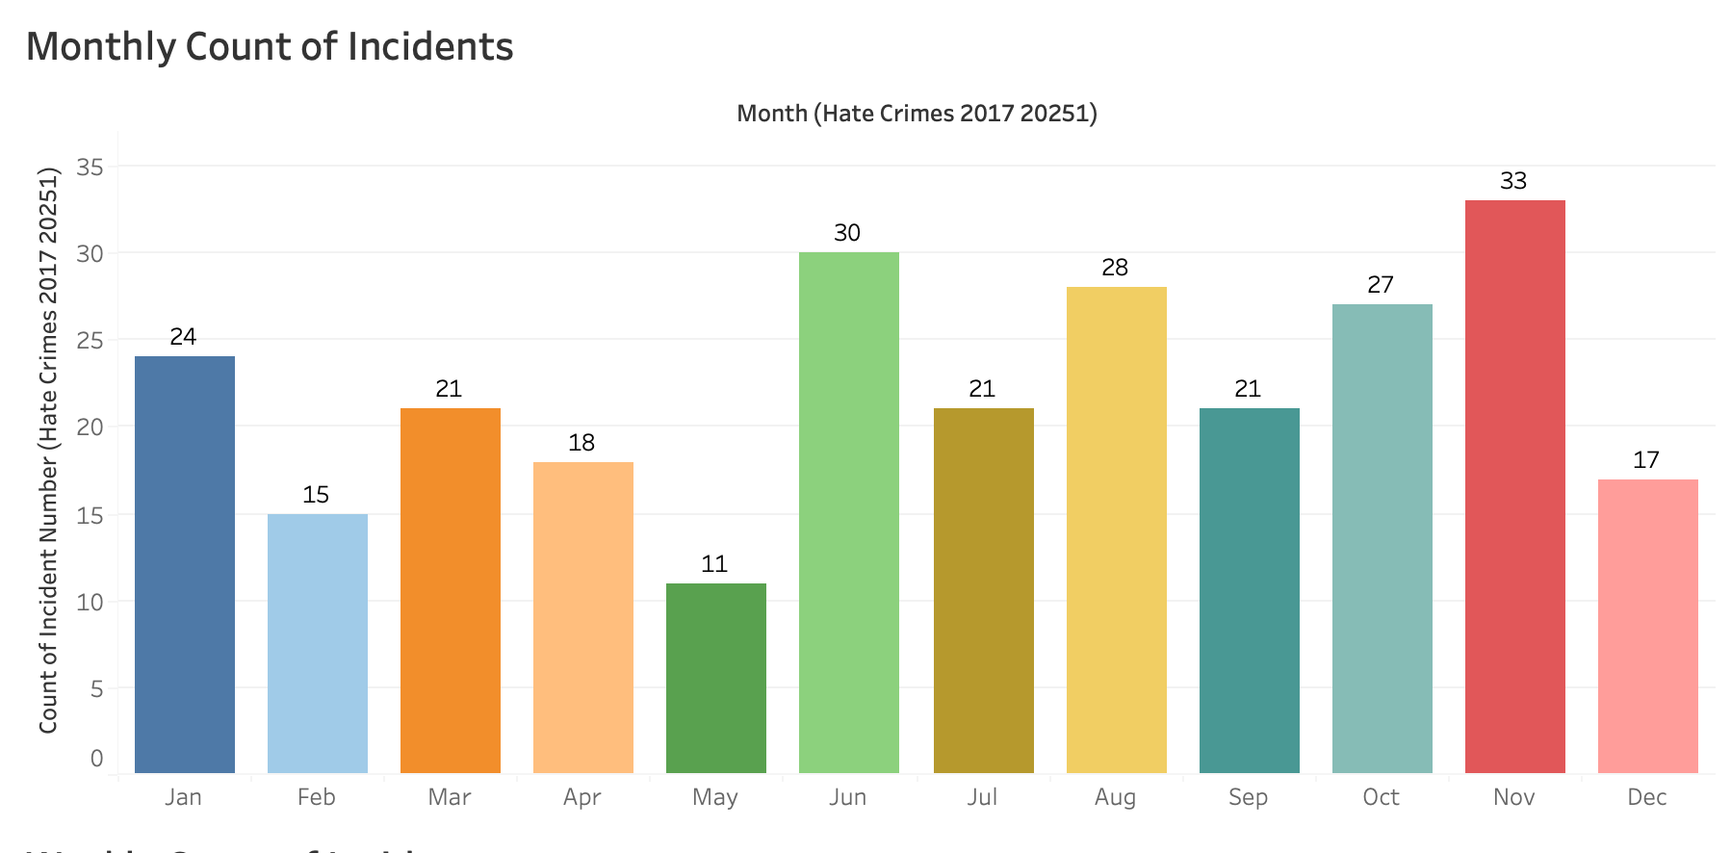
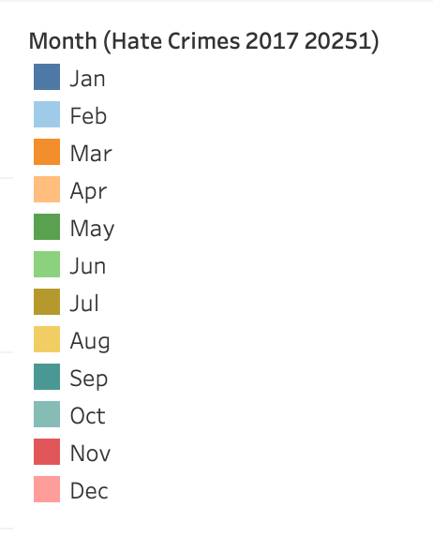
Identifying Seasonal Patterns of Hate Crime
Hate crimes tend to increase during mid-year and toward the year's end. This could relate to social or political events, holidays, or increased public gatherings during those times.

Slide 16
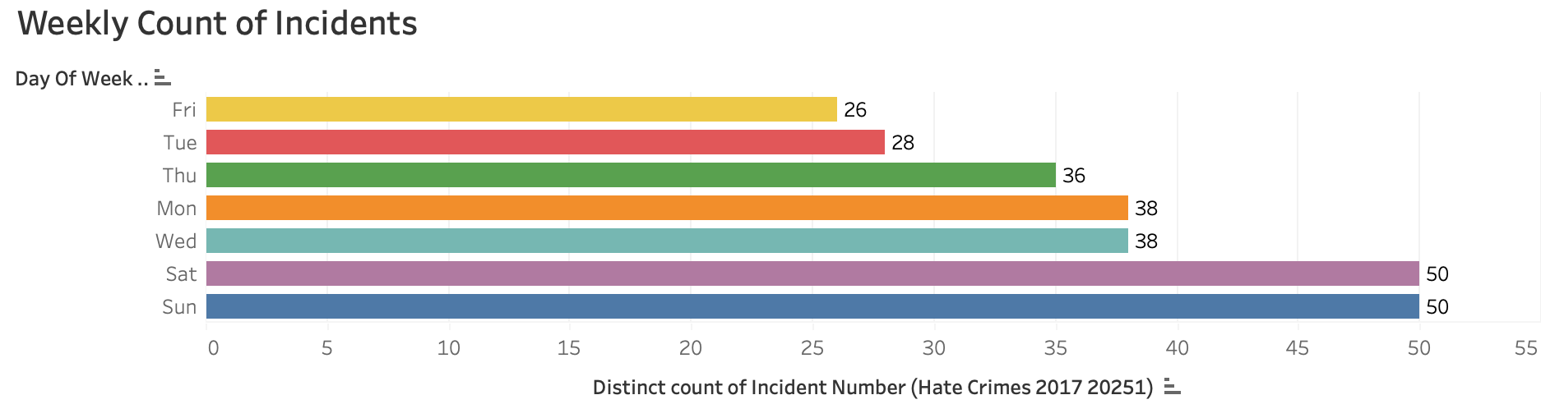
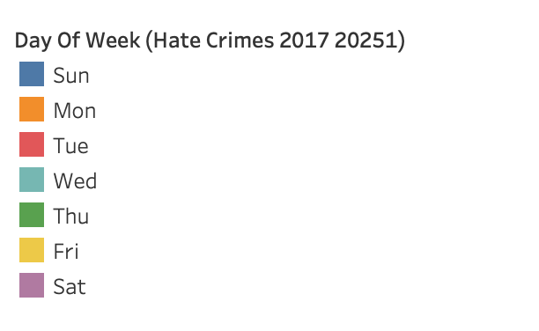
Trends in Hate Crimes Across the Week
Saturday and Sunday report the highest number of incidents (50 each), suggesting that hate crimes are most likely to occur on weekends.
Monday and Wednesday follow with 38 incidents each.
Tuesday (28) and Friday (26) show the lowest weekday activity.

Slide 17
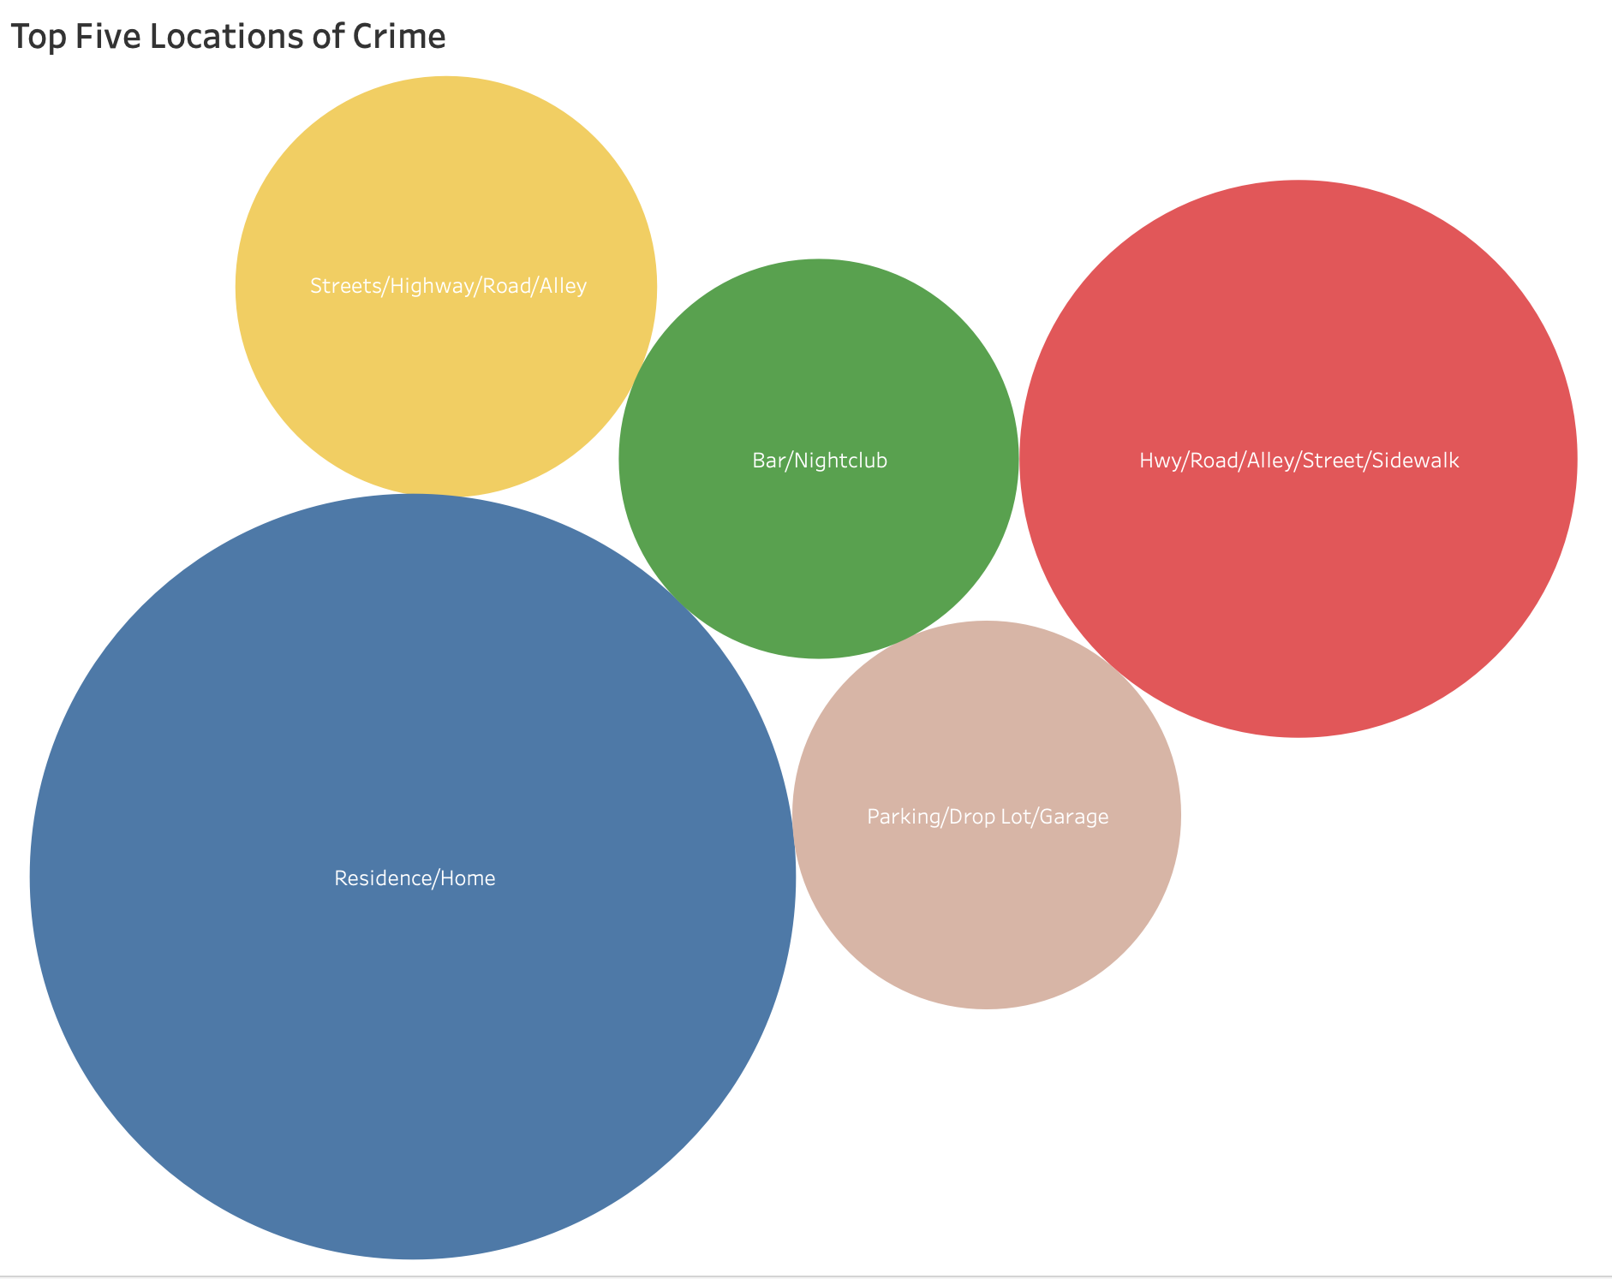
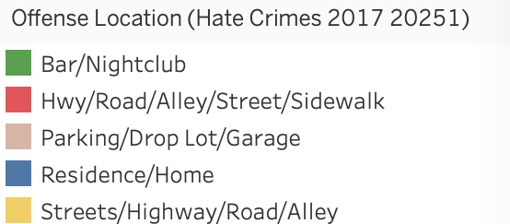
Where Hate Crimes Most Commonly Occur?
Residence/Home is the most common location, suggesting that a significant number of hate crimes occur in private or domestic settings.
Hwy/Road/Alley/Street/Sidewalk is the second-most frequent, indicating that public spaces—especially transit areas—are also high-risk zones.
Bars/Nightclubs and Parking Lots/Garages follow, suggesting that nightlife areas and isolated public places are also key hotspots.

Slide 18
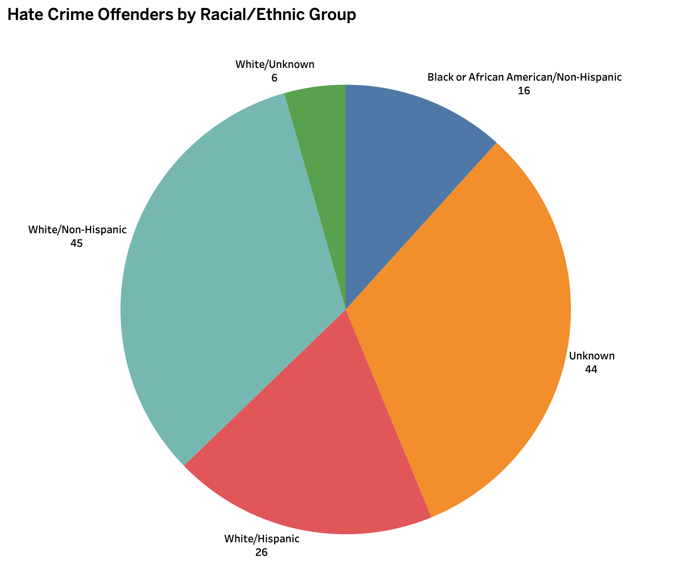
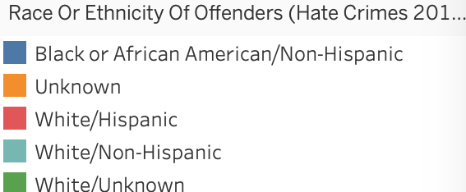
Demographics of Offenders in Reported Hate Crimes
White/Non-Hispanic offenders represent the largest known group with 45 reported cases.
Unknown offender race follows closely with 44 cases, highlighting a major gap in demographic reporting.
White/Hispanic offenders account for 26 cases, while Black or African American/Non-Hispanic offenders account for 16 cases.
White/Unknown is the smallest category, with 6 cases.

Slide 19
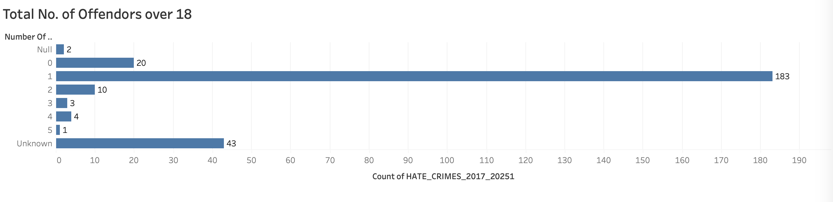
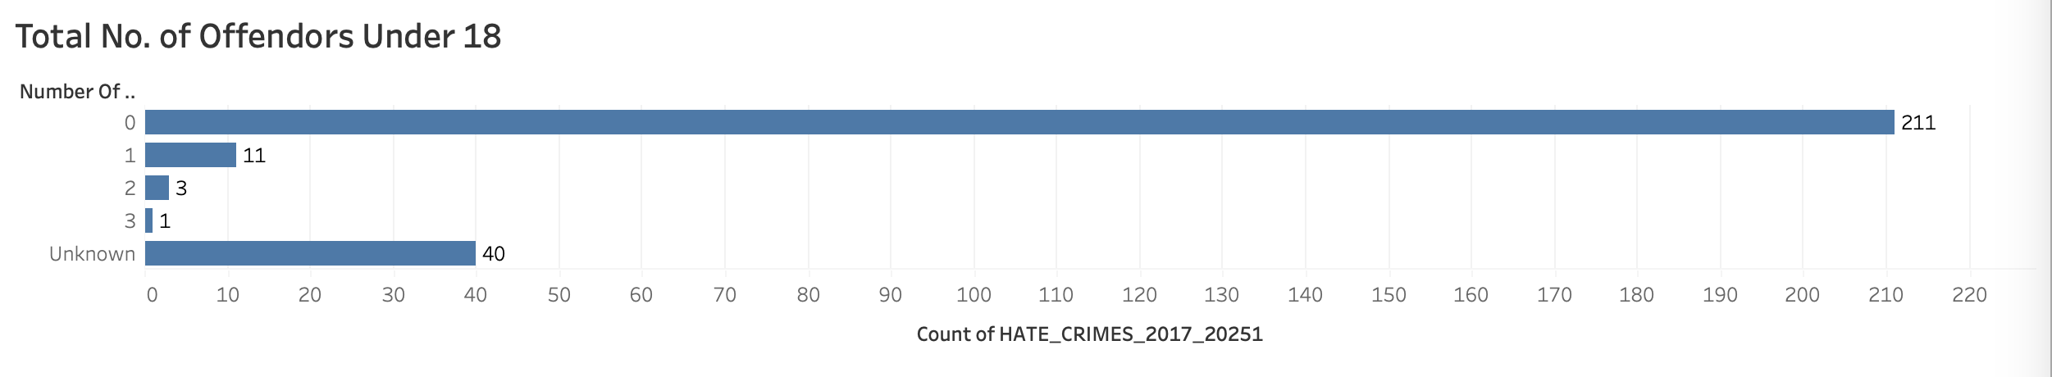
Adults VS Under-Aged Offendors
183 incidents involved exactly one adult offender, making it the most common offender profile in hate crimes.
Only 18 incidents involved two or more adult offenders, showing that group participation is relatively rare.
211 incidents had zero underage offenders, while only 15 incidents had one or more.

Slide 20
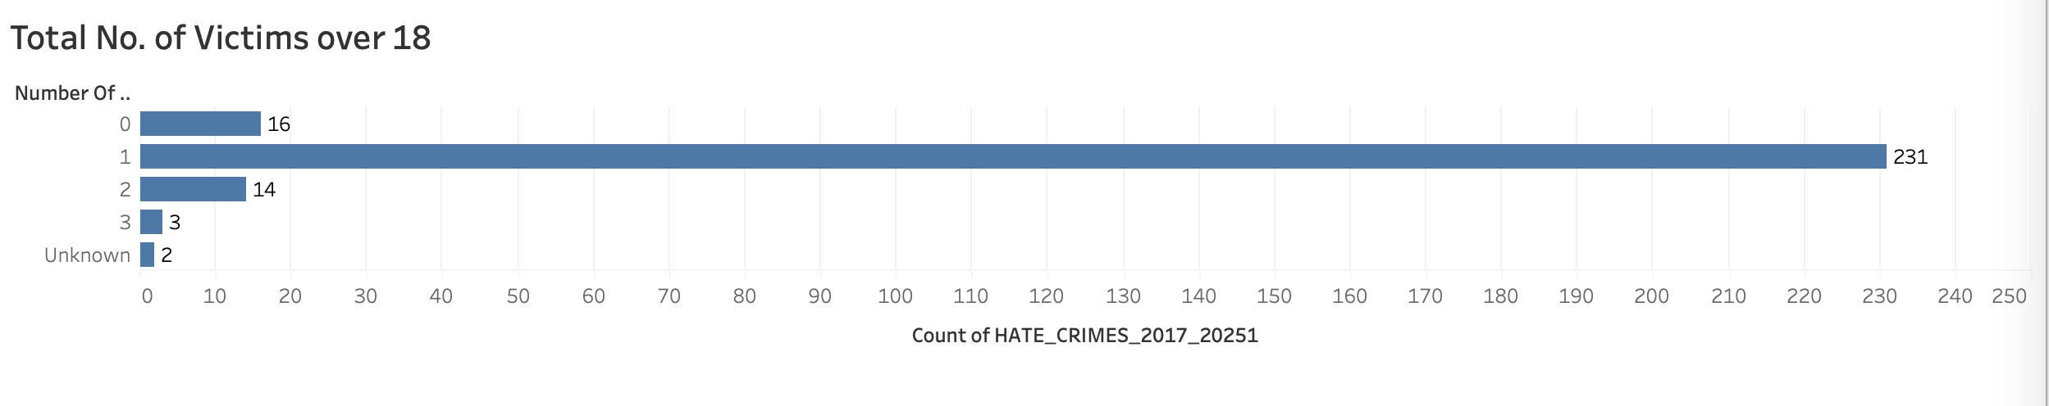
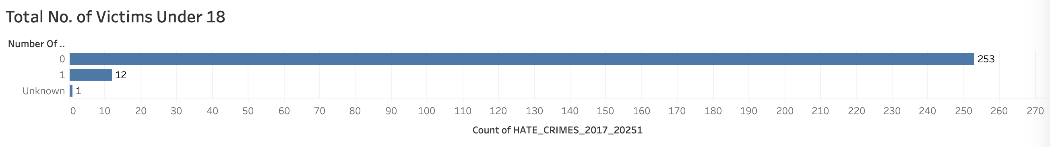
Adults VS Under-Aged Victims
231 incidents involved exactly one adult victim, making it the most common victim profile in hate crimes.
Only 19 incidents involved multiple adult victims, while 16 incidents reported no adult victims at all.
253 incidents had zero underage victims, while only 12 incidents involved one, and just 1 incident had unknown victim age data.

Slide 21
Areas of Improvement
Better Differentiation of Catagories (Bias, Offense, Race)
Getting rid of the unknowns
Timing of the Crime is not there
Forecasting Capabaility

Slide 22
Conclusion
In this project, I analyzed hate crime trends in Austin from 2017 to 2025 using Snowflake and Tableau. The findings revealed clear patterns: adults were the primary victims and offenders, incidents peaked in 2024, and most crimes occurred in private homes and public spaces like streets. Saturdays and Sundays saw the highest rates, and racial and LGBTQ+ biases were the leading motivations.
While the dashboard offered powerful insights, challenges included missing data on timing and unknown demographics. Future improvements should focus on better categorization, completeness of bias/race fields, and time-of-day details.
This project highlights how data can inform policy, prevention, and community support in tackling hate crimes.

Slide 23
Hands Up!

